Slide 1
Author: Horstmann
Title: Big Java Late Objects
“This material is reproduced with permission of John Wiley & Sons, Inc.”).
Copyright © 2013 by John Wiley & Sons. All rights reserved.

Slide 2

8
CHAPTER
OBJECTS AND CLASSES
Copyright © 2013 by John Wiley & Sons. All rights reserved.
Slides by Donald W. Smith
TechNeTrain.com
Final Draft
10/30/2011

Slide 3
Chapter Goals
To understand the concepts of classes, objects and encapsulation
To implement instance variables, methods and constructors
To be able to design, implement, and test your own classes
To understand the behavior of object references, static variables and static methods
In this chapter, you will learn how to discover, specify, and implement your own classes, and how to use them in your programs.
Copyright © 2013 by John Wiley & Sons. All rights reserved.
Page <number>

Slide 4
Contents
Object-Oriented Programming
Implementing a Simple Class
Specifying the Public Interface of a Class
Designing the Data Representation
Implementing Instance Methods
Constructors
Testing a Class
Problem Solving:
  Tracing Objects, Patterns for Object Data
Object References
Static Variables and Methods
Copyright © 2013 by John Wiley & Sons. All rights reserved.
Page <number>

Slide 5

8.1 Object-Oriented Programming
You have learned structured programming
  Breaking tasks into subtasks
  Writing re-usable methods to handle tasks
We will now study Objects and Classes
  To build larger and more complex programs
  To model objects we use in the world
A class describes objects with the same behavior. For example, a Car class describes all passenger vehicles that have a certain capacity and shape.
Copyright © 2013 by John Wiley & Sons. All rights reserved.
Page <number>

Slide 6
Objects and Programs
Java programs are made of objects that interact with each other
  Each object is based on a class
  A class describes a set of objects with the same behavior
Each class defines a specific set of methods to use with its objects
  For example, the String class provides methods:
    Examples: length() and charAt() methods
String greeting = “Hello World”;
int len = greeting.length();
char c1 = greeting.charAt(0);
Copyright © 2013 by John Wiley & Sons. All rights reserved.
Page <number>

Slide 7
Diagram of a Class
Private Data
  Each object has its own private data that other objects cannot directly access
  Methods of the public interface provide access to private data, while hiding implementation details:
  This is called Encapsulation
Public Interface
  Each object has a set of methods available for other objects to use
Class
Private Data
(Variables)
Public Interface
(Methods)
Copyright © 2013 by John Wiley & Sons. All rights reserved.
Page <number>

Slide 8

8.2 Implementing a Simple Class
Example: Tally Counter: A class that models a mechanical device that is used to count people
  For example, to find out how many people attend a concert or board a bus
What should it do?
  Increment the tally
  Get the current total
Copyright © 2013 by John Wiley & Sons. All rights reserved.
Page <number>

Slide 9
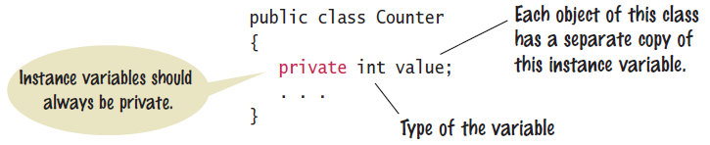
Tally Counter Class
Specify instance variables in the class declaration:
Each object instantiated from the class has its own set of instance variables
  Each tally counter has its own current count
Access Specifiers:
  Classes (and interface methods) are public
  Instance variables are always private
Copyright © 2013 by John Wiley & Sons. All rights reserved.
Page <number>

Slide 10
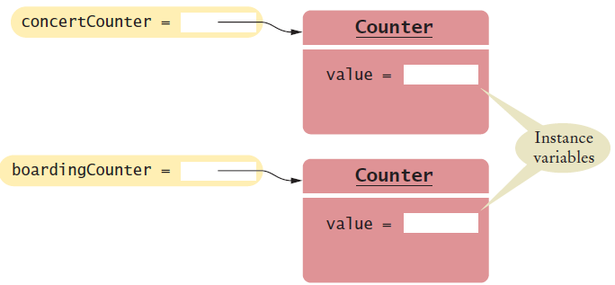
Instantiating Objects
Objects are created based on classes
  Use the new operator to construct objects
  Give each object a unique name (like variables)
You have used the new operator before:
Creating two instances of Counter objects:
Scanner in = new Scanner(System.in);
Class name
Object name
Class name
Counter concertCounter = new Counter();
Counter boardingCounter = new Counter();
Use the new operator to construct objects of a class.
Copyright © 2013 by John Wiley & Sons. All rights reserved.
Page <number>

Slide 11
Tally Counter Methods
Design a method named count that adds 1 to the instance variable
Which instance variable?
  Use the name of the object
    concertCounter.count()
    boardingCounter.count()
public class Counter
{
private int value;
public void count()
{
value = value + 1;
}
public int getValue()
{
return value;
}
}
Copyright © 2013 by John Wiley & Sons. All rights reserved.
Page <number>

Slide 12
8.3 Public Interface of a Class
When you design a class, start by specifying the public interface of the new class
  Example: A Cash Register Class
    What tasks will this class perform?
    What methods will you need?
    What parameters will the methods need to receive?
    What will the methods return?
Task | Method | Returns
Add the price of an item | addItem(double) | void
Get the total amount owed | getTotal() | double
Get the count of items purchased | getCount() | int
Clear the cash register for a new sale | clear() | void
Copyright © 2013 by John Wiley & Sons. All rights reserved.
Page <number>

Slide 13
Writing the Public Interface
/**
A simulated cash register that tracks the item count
and the total amount due.
*/
public class CashRegister
{
/**
Adds an item to this cash register.
@param price: the price of this item
*/
public void addItem(double price)
{
// Method body
}
/**
Gets the price of all items in the current sale.
@return the total price
*/
public double getTotal() ...
Javadoc style comments document the class and the behavior of each method
The method declarations make up the public interface of the class
The data and method bodies make up the private implementation of the class
Copyright © 2013 by John Wiley & Sons. All rights reserved.
Page <number>

Slide 14
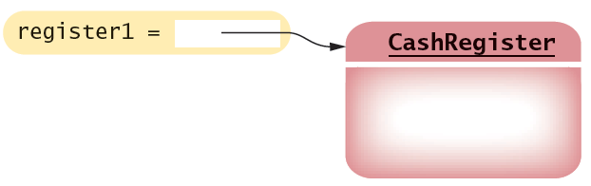
Non-static Methods Means…
We have been writing class methods using the static modifier:
For non-static (instance) methods, you must instantiate an object of the class before you can invoke methods
  Then invoke methods of the object
public static void addItem(double val)
public void addItem(double val)
public static void main(String[] args)
{
// Construct a CashRegister object
CashRegister register1 = new CashRegister();
// Invoke a non-static method of the object
register1.addItem(1.95);
}
Copyright © 2013 by John Wiley & Sons. All rights reserved.
Page <number>

Slide 15
Accessor and Mutator Methods
Many methods fall into two categories:
  1) Accessor Methods: 'get' methods
    Asks the object for information without changing it
    Normally return a value of some type
  2) Mutator Methods: 'set' methods
    Changes values in the object
    Usually take a parameter that will change an instance variable
    Normally return void
public double getTotal() { }
public int getCount() { }
public void addItem(double price) { }
public void clear() { }
Copyright © 2013 by John Wiley & Sons. All rights reserved.
Page <number>

Slide 16
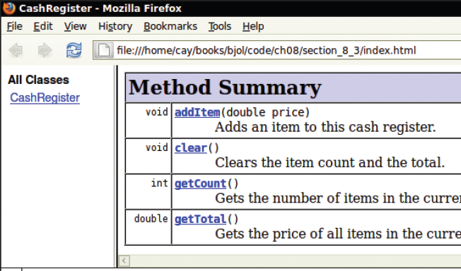
Special Topic 8.1: Javadoc
The Javadoc utility generates a set of HTML files from the Javadoc style comments in your source code
  Methods document parameters and returns:
    @param
    @return
Copyright © 2013 by John Wiley & Sons. All rights reserved.
Page <number>

Slide 17
8.4 Designing the Data Representation
An object stores data in instance variables
  Variables declared inside the class
  All methods inside the class have access to them
    Can change or access them
  What data will our CashRegister methods need?
Task | Method | Data Needed
Add the price of an item | addItem() | total, count
Get the total amount owed | getTotal() | total
Get the count of items purchased | getCount() | count
Clear the cash register for a new sale | clear() | total, count
An object holds instance variables that are accessed by methods
Copyright © 2013 by John Wiley & Sons. All rights reserved.
Page <number>

Slide 18

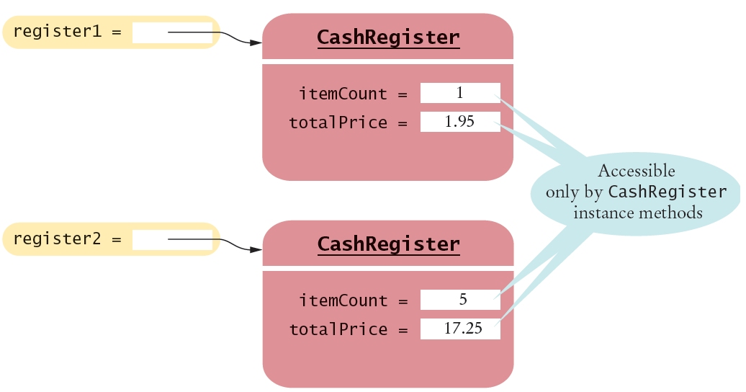
Instance Variables of Objects
Each object of a class has a separate set of instance variables.
The values stored in instance variables make up the state of the object.
Copyright © 2013 by John Wiley & Sons. All rights reserved.
Page <number>

Slide 19
Accessing Instance Variables
private instance variables cannot be accessed from methods outside of the class
public static void main(String[] args)
{
. . .
System.out.println(register1.itemCount); // Error
. . .
}
The compiler will not allow this violation of privacy
Use accessor methods of the class instead!
public static void main(String[] args)
{
. . .
System.out.println( register1.getCount() ); // OK
. . .
}
Encapsulation provides a public interface and hides the implementation details.
Copyright © 2013 by John Wiley & Sons. All rights reserved.
Page <number>

Slide 20
8.5 Implementing Instance Methods
Implement instance methods that will use the private instance variables
public void addItem(double price)
{
itemCount++;
totalPrice = totalPrice + price;
}
Task | Method | Returns
Add the price of an item | addItem(double) | void
Get the total amount owed | getTotal() | double
Get the count of items purchased | getCount() | int
Clear the cash register for a new sale | clear() | void
Copyright © 2013 by John Wiley & Sons. All rights reserved.
Page <number>

Slide 21
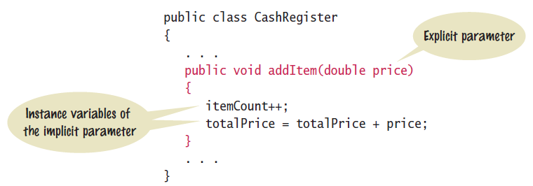
Syntax 8.2: Instance Methods
Use instance variables inside methods of the class
  There is no need to specify the implicit parameter (name of the object) when using instance variables inside the class
  Explicit parameters must be listed in the method declaration
Copyright © 2013 by John Wiley & Sons. All rights reserved.
Page <number>

Slide 22
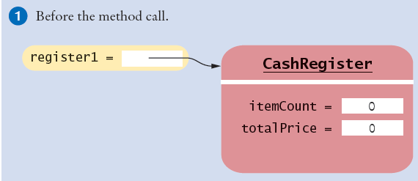
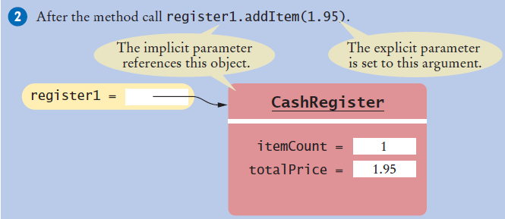
Implicit and Explicit Parameters
When an item is added, it affects the instance variables of the object on which the method is invoked
The object on which a method is applied is the implicit parameter
Copyright © 2013 by John Wiley & Sons. All rights reserved.
Page <number>

Slide 23
8.6 Constructors
A constructor is a method that initializes instance variables of an object
  It is automatically called when an object is created
  It has exactly the same name as the class
public class CashRegister
{
. . .
/**
Constructs a cash register with cleared item count and total.
*/
public CashRegister() // A constructor
{
itemCount = 0;
totalPrice = 0;
}
}
Constructors never return values, but do not use void in their declaration
Copyright © 2013 by John Wiley & Sons. All rights reserved.
Page <number>

Slide 24
Multiple Constructors
A class can have more than one constructor
  Each must have a unique set of parameters
public class BankAccount
{
. . .
/**
Constructs a bank account with a zero balance.
*/
public BankAccount( ) { . . . }
/**
Constructs a bank account with a given balance.
@param initialBalance the initial balance
*/
public BankAccount(double initialBalance) { . . . }
}
The compiler picks the constructor that matches the construction parameters.
BankAccount joesAccount = new BankAccount();
BankAccount lisasAccount = new BankAccount(499.95);
Copyright © 2013 by John Wiley & Sons. All rights reserved.
Page <number>

Slide 25
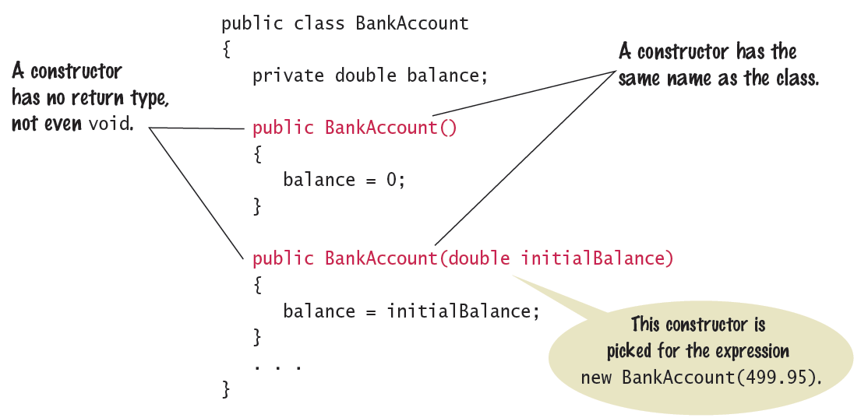
Syntax 8.3: Constructors
One constructors is invoked when the object is created with the new keyword
Copyright © 2013 by John Wiley & Sons. All rights reserved.
Page <number>

Slide 26
The Default Constructor
If you do not supply any constructors, the compiler will make a default constructor automatically
  It takes no parameters
  It initializes all instance variables
public class CashRegister
{
. . .
/**
Does exactly what a compiler generated constructor would do.
*/
public CashRegister()
{
itemCount = 0;
totalPrice = 0;
}
}
By default, numbers are initialized to 0, booleans to false, and objects as null.
Copyright © 2013 by John Wiley & Sons. All rights reserved.
Page <number>

Slide 27
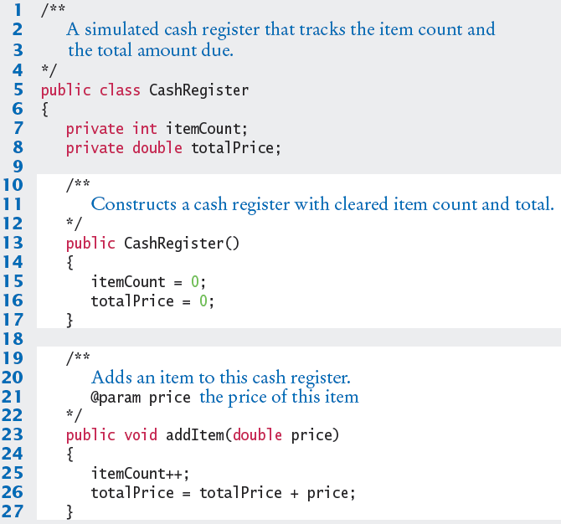
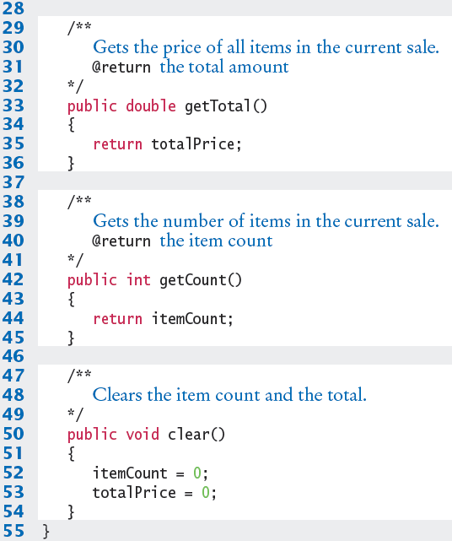
CashRegister.java
Copyright © 2013 by John Wiley & Sons. All rights reserved.
Page <number>

Slide 28

Common Error 8.1
Not initializing object references in constructor
  References are by default initialized to null
  Calling a method on a null reference results in a runtime error: NullPointerException
  The compiler catches uninitialized local variables for you
public class BankAccount
{
private String name; // default constructor will set to null
public void showStrings()
{
String localName;
System.out.println(name.length());
System.out.println(localName.length());
}
}
Runtime Error: java.lang.NullPointerException
Compiler Error: variable localName might not have been initialized
Copyright © 2013 by John Wiley & Sons. All rights reserved.
Page <number>

Slide 29
Common Error 8.2
Trying to Call a Constructor
  You cannot call a constructor like other methods
  It is ‘invoked’ for you by the new reserved word
  You cannot invoke the constructor on an existing object:
  But you can create a new object using your existing reference
CashRegister register1 = new CashRegister();
register1.CashRegister(); // Error
CashRegister register1 = new CashRegister();
Register1.newItem(1.95);
CashRegister register1 = new CashRegister();
Copyright © 2013 by John Wiley & Sons. All rights reserved.
Page <number>

Slide 30
Common Error 8.3
Declaring a Constructor as void
  Constructors have no return type
  This creates a method with a return type of void which is NOT a constructor!
    The Java compiler does not consider this an error
public class BankAccount
{
/**
Intended to be a constructor.
*/
public void BankAccount( )
{
. . .
}
}
Not a constructor…. Just another method that returns nothing (void)
Copyright © 2013 by John Wiley & Sons. All rights reserved.
Page <number>

Slide 31

Special Topic 8.2
Overloading
  We have seen that multiple constructors can have exactly the same name
    They require different lists of parameters
  Actually any method can be overloaded
    Same method name with different parameters
  We will not be using overloading in this book
    Except as required for constructors
void print(CashRegister register) { . . . }
void print(BankAccount account) { . . . }
void print(int value) { . . . }
Void print(double value) { . . . }
Copyright © 2013 by John Wiley & Sons. All rights reserved.
Page <number>

Slide 32
8.7 Testing a Class
We wrote a CashRegister class but…
  You cannot execute the class – it has no main method
It can become part of a larger program
  Test it first though with unit testing
To test a new class, you can use:
  Programming tools that interactively create objects:
    DrJava: www.drjava.org
    BlueJ: www.bluej.org
  Or write a tester class:
    With a main
public class CashRegisterTester
{
public static void main(String[] args)
{
CashRegister c1 = new CashRegister();
...
Copyright © 2013 by John Wiley & Sons. All rights reserved.
Page <number>

Slide 33
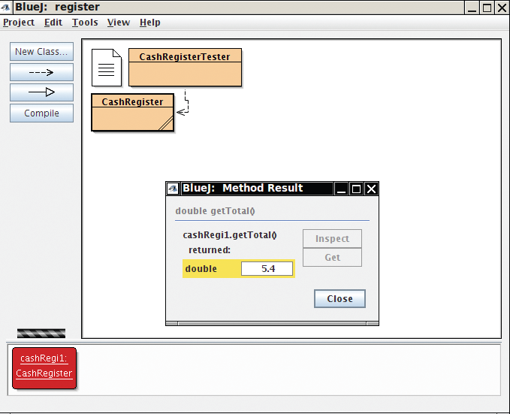
BlueJ: An IDE for Testing
BlueJ can interactively instantiate objects of a class, and allows you to invoke their methods
  Great for testing!
Copyright © 2013 by John Wiley & Sons. All rights reserved.
Page <number>

Slide 34
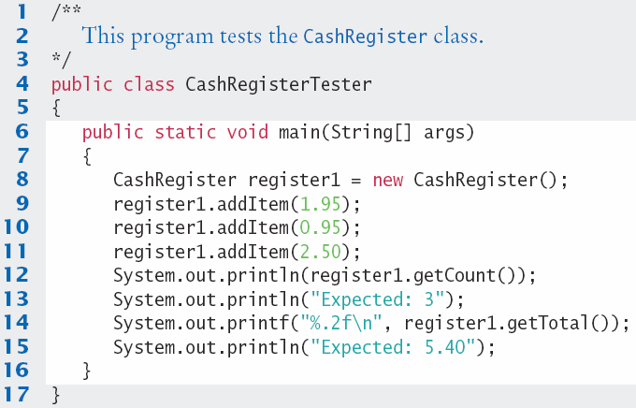
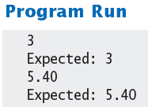
CashRegisterTester.java
Test all methods
  Print expected results
  Output actual results
  Compare results
A unit test verifies that a class works correctly in isolation, outside a complete program.
Copyright © 2013 by John Wiley & Sons. All rights reserved.
Page <number>

Slide 35

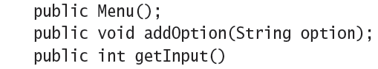
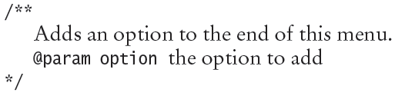
Steps to Implementing a Class
1) Get an informal list of responsibilities for your objects
2) Specify the public interface
3) Document the public interface
  Javadoc comments
Copyright © 2013 by John Wiley & Sons. All rights reserved.
Page <number>

Slide 36
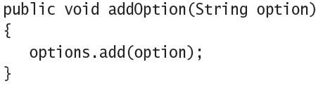
Steps to Implementing a Class
4) Determine the instance variables
5) Implement constructors and methods
6) Test your class
Copyright © 2011 by John Wiley & Sons. All rights reserved.
Page <number>

Slide 37
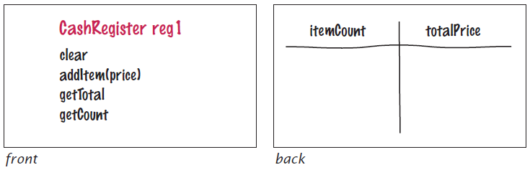
8.8 Problem Solving: Tracing Objects
Use an Index card for each object
  An object is manipulated through the public interface (front of the card)
  The encapsulated data is on the back of the card
Copyright © 2013 by John Wiley & Sons. All rights reserved.
Page <number>

Slide 38
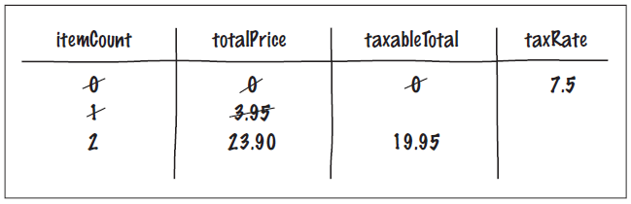
Mutator Methods and Cards
As mutator methods are called, keep track of the value of instance variables
CashRegister reg2(7.5); // 7.5 percent sales tax
reg2.addItem(3.95, false); // Not taxable
reg2.addItem(19.95, true); // Taxable
Copyright © 2013 by John Wiley & Sons. All rights reserved.
Page <number>

Slide 39
8.9 Problem Solving
Patterns for Object Data
Common patterns when designing instance variables
  Keeping a Total
  Counting Events
  Collecting Values
  Managing Object Properties
  Modeling Objects with Distinct States
  Describing the Position of an Object
Copyright © 2013 by John Wiley & Sons. All rights reserved.
Page <number>

Slide 40
Patterns: Keeping a Total
Examples
  Bank account balance
  Cash Register total
  Car gas tank fuel level
Variables needed
  Total (totalPrice)
Methods Required
  Add (addItem)
  Clear
  getTotal
public class CashRegister
{
private double totalPrice;
public void addItem(double price)
{
totalPrice += price;
}
public void clear()
{
totalPrice = 0;
}
public double getTotal()
{
return totalPrice;
}
}
Copyright © 2013 by John Wiley & Sons. All rights reserved.
Page <number>

Slide 41
Patterns: Counting Events
Examples
  Cash Register items
  Bank transaction fee
Variables needed
  Count
Methods Required
  Add
  Clear
  Optional: getCount
public class CashRegister
{
private double totalPrice;
private int itemCount;
public void addItem(double price)
{
totalPrice += price;
itemCount++;
}
public void clear()
{
totalPrice = 0;
itemCount = 0;
}
public double getCount()
{
return itemCount;
}
}
Copyright © 2013 by John Wiley & Sons. All rights reserved.
Page <number>

Slide 42
Patterns: Collecting Values
Examples
  Multiple choice question
  Shopping cart
Storing values
  Array or ArrayList
Constructor
  Initialize to empty collection
Methods Required
  Add
public class Cart
{
private String[] items;
private int itemCount;
public Cart() // Constructor
{
items = new String[50];
itemCount = 0;
}
public void addItem(String name)
{
if(itemCount < 50)
{
items[itemCount] = name;
itemCount++;
}
}
}
Copyright © 2013 by John Wiley & Sons. All rights reserved.
Page <number>

Slide 43
Patterns: Managing Properties
A property of an object can be set and retrieved
Examples
  Student: name, ID
Constructor
  Set a unique value
Methods Required
  set
  get
public class Student
{
private String name;
private int ID;
public Student(int anID)
{
ID = anID;
}
public void setName(String newname)
{
if (newName.length() > 0)
name = newName;
}
public getName()
{
return name;
}
}
Copyright © 2013 by John Wiley & Sons. All rights reserved.
Page <number>

Slide 44

Patterns: Modeling Stateful Objects
Some objects can be in one of a set of distinct states.
Example: A fish
  Hunger states:
    Somewhat Hungry
    Very Hungry
    Not Hungry
Methods will change the state
  eat
  move
public class Fish
{
private int hungry;
public static final int NOT_HUNGRY = 0;
public static final int SOMEWHAT_HUNGRY = 1;
public static final int VERY_HUNGRY = 2;
public void eat()
{
hungry = NOT_HUNGRY;
}
public void move()
{
if (hungry < VERY_HUNGRY)
{ hungry++; }
}
Copyright © 2013 by John Wiley & Sons. All rights reserved.
Page <number>

Slide 45

Patterns: Object Position
Examples
  Game object
  Bug (on a grid)
  Cannonball
Storing values
  Row, column, direction, speed. . .
Methods Required
  move
  turn
public class Bug
{
private int row;
private int column;
private int direction;
// 0 = N, 1 = E, 2 = S, 3 = W
public void moveOneUnit()
{
switch(direction) {
case 0: row--; break;
case 1: column++; break;
. . .
}
}
}
Copyright © 2013 by John Wiley & Sons. All rights reserved.
Page <number>

Slide 46
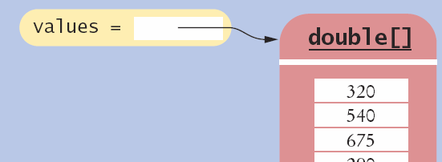
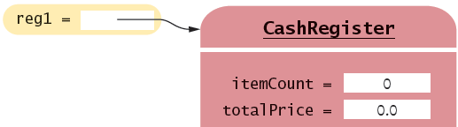
8.10 Object References
Objects are similar to arrays because they always have reference variables
  Array Reference
  Object Reference
double[] values = new double[5];
CashRegister reg1 = new CashRegister;
An object reference specifies the memory location of the object
Copyright © 2013 by John Wiley & Sons. All rights reserved.
Page <number>

Slide 47
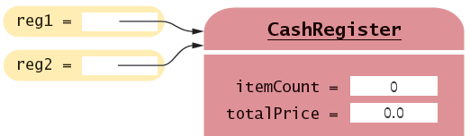
Shared References
Multiple object variables may contain references to the same object.
  Single Reference
  Shared References
CashRegister reg1 = new CashRegister;
CashRegister reg2 = reg1;
The internal values can be changed through either reference
Copyright © 2013 by John Wiley & Sons. All rights reserved.
Page <number>

Slide 48
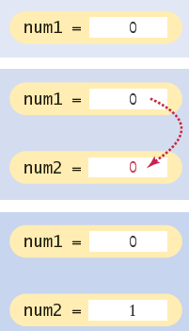
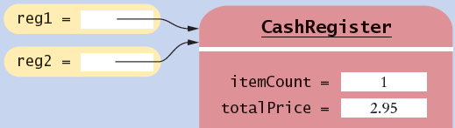
Primitive versus Reference Copy
Primitive variables can be copied, but work differently than object references
  Primitive Copy Reference Copy
    Two locations One location for both
int num1 = 0;
int num2 = num1;
num2++;
CashRegister reg1 = new CashRegister;
CashRegister reg2 = reg1;
reg2.addItem(2.95);
Why? Primitives take much less storage space than objects!
Copyright © 2013 by John Wiley & Sons. All rights reserved.
Page <number>

Slide 49
The null reference
A reference may point to ‘no’ object
  You cannot invoke methods of an object via a null reference – causes a run-time error
  To test if a reference is null before using it:
CashRegister reg = null;
System.out.println(reg.getTotal()); // Runtime Error!
String middleInitial = null; // No middle initial
if (middleInitial == null)
System.out.println(firstName + " " + lastName);
else
System.out.println(firstName + " " + middleInitial + ". " + lastName);
Copyright © 2013 by John Wiley & Sons. All rights reserved.
Page <number>

Slide 50
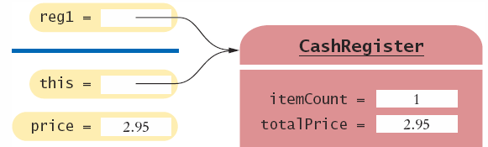
The this reference
Methods receive the ‘implicit parameter’ in a reference variable called ‘this’
  It is a reference to the object the method was invoked on:
  It can clarify when instance variables are used:
void addItem(double price)
{
this.itemCount++;
this.totalPrice = this.totalPrice + price;
}
Copyright © 2013 by John Wiley & Sons. All rights reserved.
Page <number>

Slide 51
Constructor this reference
Sometimes people use the this reference in constructors
  It makes it very clear that you are setting the instance variable:
public class Student
{
private int id;
private String name;
public Student(int id, String name)
{
this.id = id;
this.name = name;
}
}
Copyright © 2013 by John Wiley & Sons. All rights reserved.
Page <number>

Slide 52

8.11 Static Variables and Methods
Variables can be declared as static in the Class declaration
  There is one copy of a static variable that is shared among all objects of the Class
public class BankAccount
{
private double balance;
private int accountNumber;
private static int lastAssignedNumber = 1000;
public BankAccount()
{
lastAssignedNumber++;
accountNumber = lastAssignedNumber;
}
. . .
}
Methods of any object of the class can use or change the value of a static variable
Copyright © 2013 by John Wiley & Sons. All rights reserved.
Page <number>

Slide 53
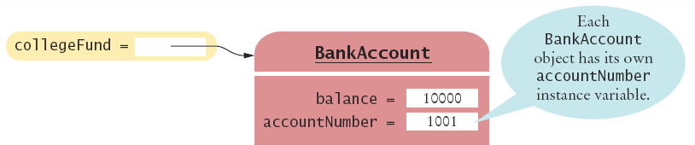
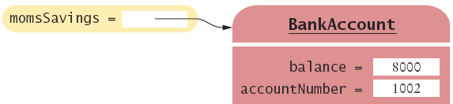
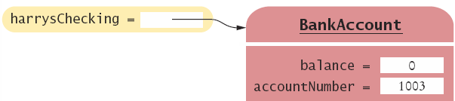
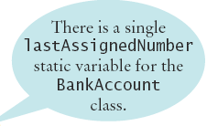
Using Static Variables
Example:
  Each time a new account is created, the lastAssignedNumber variable is incremented by the constructor
Access the static variable using:
  ClassName.variableName
Copyright © 2013 by John Wiley & Sons. All rights reserved.
Page <number>

Slide 54
Using Static Methods
The Java API has many classes that provide methods you can use without instantiating objects
  The Math class is an example we have used
  Math.sqrt(value) is a static method that returns the square root of a value
  You do not need to instantiate the Math class first
Access static methods using:
  ClassName.methodName()
Copyright © 2013 by John Wiley & Sons. All rights reserved.
Page <number>

Slide 55
Writing your own Static Methods
You can define your own static methods
public class Financial
{
/**
Computes a percentage of an amount.
@param percentage the percentage to apply
@param amount the amount to which the percentage is applied
@return the requested percentage of the amount
*/
public static double percentOf(double percentage, double amount)
{
return (percentage / 100) * amount;
}
}
static methods usually return a value. They can only access static variables and methods.
Invoke the method on the Class, not an object
double tax = Financial.percentOf(taxRate, total);
Copyright © 2013 by John Wiley & Sons. All rights reserved.
Page <number>

Slide 56
Summary: Classes and Objects
A class describes a set of objects with the same behavior.
  Every class has a public interface: a collection of methods through which the objects of the class can be manipulated.
  Encapsulation is the act of providing a public interface and hiding the implementation details.
  Encapsulation enables changes in the implementation without affecting users of a class
Copyright © 2013 by John Wiley & Sons. All rights reserved.
Page <number>

Slide 57
Summary: Variables and Methods
An object’s instance variables store the data required for executing its methods.
Each object of a class has its own set of instance variables.
An instance method can access the instance variables of the object on which it acts.
A private instance variable can only be accessed by the methods of its own class.
Variables declared as static in a class have a single copy of the variable shared among all of the instances of the class.
Copyright © 2013 by John Wiley & Sons. All rights reserved.
Page <number>

Slide 58
Summary: Method Headers, Data
Method Headers
  You can use method headers and method comments to specify the public interface of a class.
  A mutator method changes the object on which it operates.
  An accessor method does not change the object on which it operates.
Data Declaration
  For each accessor method, an object must either store or compute the result.
  Commonly, there is more than one way of representing the data of an object, and you must make a choice.
  Be sure that your data representation supports method calls in any order.
Copyright © 2013 by John Wiley & Sons. All rights reserved.
Page <number>

Slide 59
Summary: Parameters, Constructors
Methods Parameters
  The object on which a method is applied is the implicit parameter.
  Explicit parameters of a method are listed in the method declaration.
Constructors
  A constructor initializes the object’s instance variables
  A constructor is invoked when an object is created with the new operator.
  The name of a constructor is the same as the class
  A class can have multiple constructors.
  The compiler picks the constructor that matches the construction arguments.
Copyright © 2013 by John Wiley & Sons. All rights reserved.
Page <number>

